Slide 1
Web Automation for Software Testers
TestNG and Assertions in Selenium

Slide 2
Agenda
What is TestNG
Use of TestNG
Assertions with Selenium

Slide 3
What is TestNG
Introduction:
TestNG is an automation testing framework in which NG stands for "Next Generation". TestNG is inspired from JUnit which uses the annotations (@).
Using TestNG you can generate a proper report, and you can easily come to know how many test cases are passed, failed and skipped.
You can execute failed test case separately.

Slide 4
What is TestNG
Introduction:
Suppose, you have five test cases, one method is written for each test case (assume that the program is written using the main method without using TestNG).
When you run this program, first three methods are executed successfully, and the fourth method is failed. Then correct the errors present in the fourth method, now you want to run only fourth method because first three methods are anyway executed successfully. This is not possible without using TestNG.

Slide 5

What is TestNG
Introduction:
The TestNG provides an option, i.e., testng-failed.xml file in test-output folder. If you want to run only failed test cases means you run this XML file. It will execute only failed test cases.

Slide 6
What is TestNG
Why to use TestNG:
Default Selenium tests do not generate a proper format for the test results. Using TestNG we can generate test results.
Most Selenium users use this more than Junit because of its advantages. There are so many features of TestNG, but we will only focus on the most important ones that we can use in Selenium.

Slide 7
What is TestNG
Why to use TestNG:
Features of TestNG with Selenium:
TestNG can generate the report in a readable format;
Multiple test cases can be grouped more easily;
Execute same test case multiple times without loop;
Execute multiple test cases on multiple browsers;
Annotations used in the testing are very easy to understand;
TestNG simplifies the way the tests are coded;
Uncaught exceptions are automatically handled by TestNG.

Slide 8

What is TestNG
Why to use TestNG:
Advantages of TestNG over JUnit:
Annotations are easier to understand
Test cases can be grouped more easily
Parallel testing is possible

Slide 9
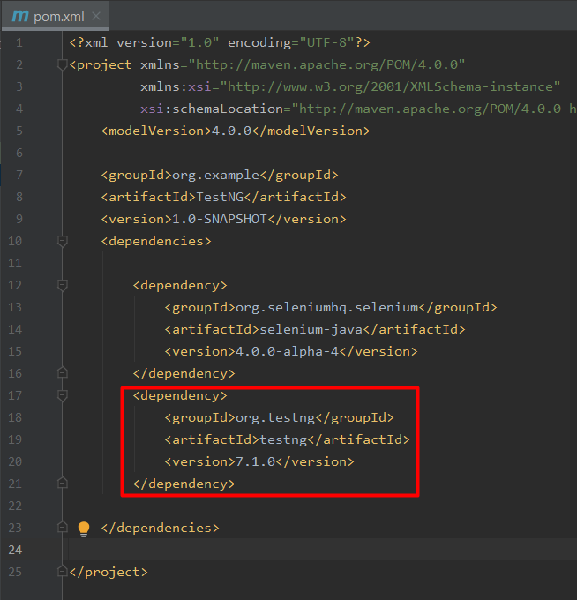
Use of TestNG
Create TestNG Project:
Like we created every Maven project until now, in the same way we will create new project in which we will include TestNG dependency.

Slide 10
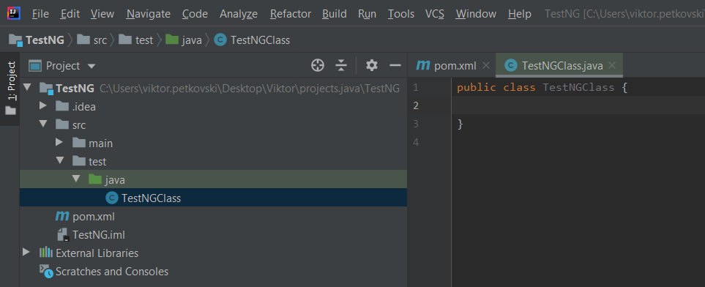
Use of TestNG
Create TestNG Project:
Next thing to do would be to create new Java class, again in the same way as previous projects:

Slide 11
Use of TestNG
Create Methods using Annotations:
TestNG Annotation is a piece of code which is inserted inside a program or business logic used to control the flow of execution of test methods.
Annotations were formally added to the Java language in JDK 5, and TestNG made the choice to use annotations to annotate test classes.
This is a very effective method for tagging certain methods in a class as having a special meaning.

Slide 12
Use of TestNG
Create Methods using Annotations:
Benefits of using Annotations:
TestNG identifies the methods it is interested in, by looking up annotations. Hence, method names are not restricted to any pattern or format.
We can pass additional parameters to annotations.
Annotations are strongly typed, so the compiler will flag any mistakes right away.

Slide 13
Use of TestNG
Create Methods using Annotations:
TestNG Annotation | Description
@BeforeSuite | This annotated method will run before the execution of all the test methods in the suite.
@AfterSuite | This annotated method will run after the execution of all the test methods in the suite.
@BeforeTest | This annotated method will be executed before the execution of all the test methods of available classes belonging to that folder.
@AfterTest | This annotated method will be executed after the execution of all the test methods of available classes belonging to that folder.
@BeforeClass | This annotated method will be executed before the first method of the current class is invoked.
@AfterClass | This annotated method will be invoked after the execution of all the test methods of the current class.
@BeforeMethod | This annotated method will be executed before each test method will run.
@AfterMethod | This annotated method will run after the execution of each test method.
@BeforeGroups | This annotated method run only once for a group before the execution of all test cases belonging to that group.
@AfterGroups | This annotated method run only once for a group after the execution of all test cases belonging to that group.

Slide 14
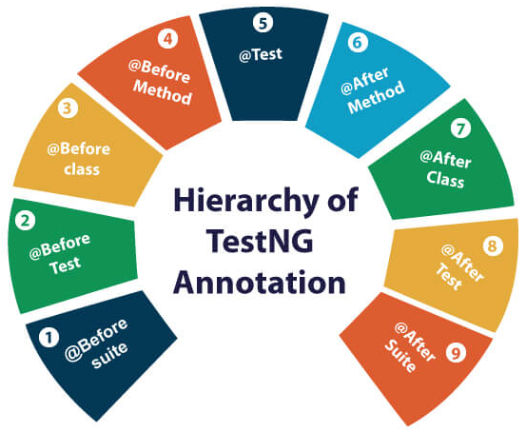
Use of TestNG
Create Methods using Annotations:
Hierarchy of the TestNG Annotations:
@BeforeSuite
@BeforeTest
@BeforeClass
@BeforeMethod
@Test
@AfterMethod
@AfterClass
@AfterTest
@AfterSuite

Slide 15
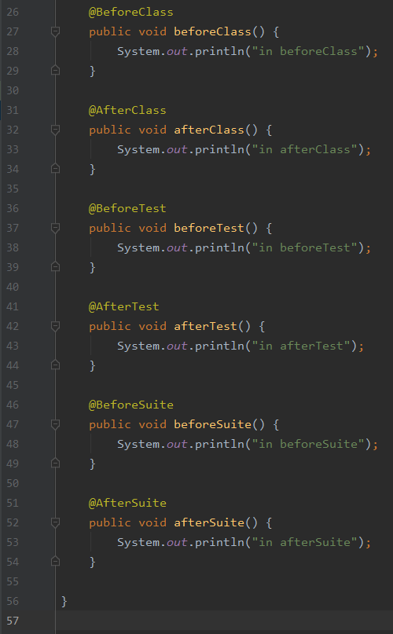
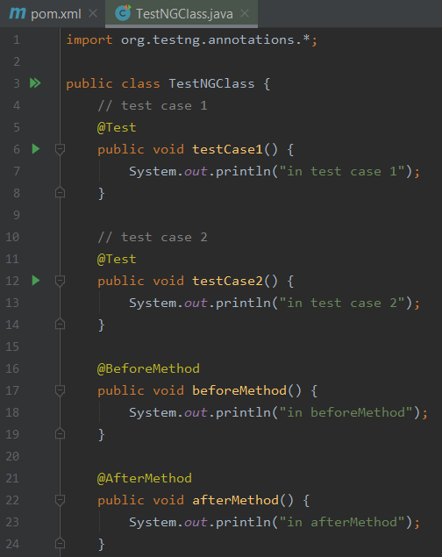
Use of TestNG
Create Methods using Annotations:

Slide 16
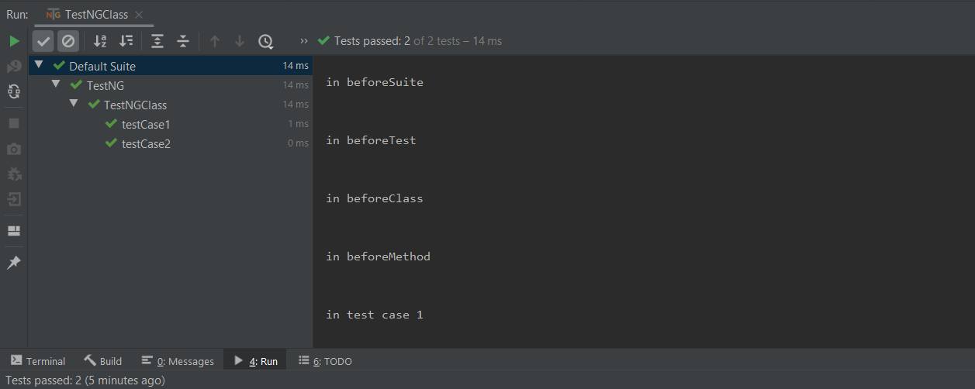
Use of TestNG
Create Methods using Annotations:
Outcome of test execution with all related annotated methods:

Slide 17
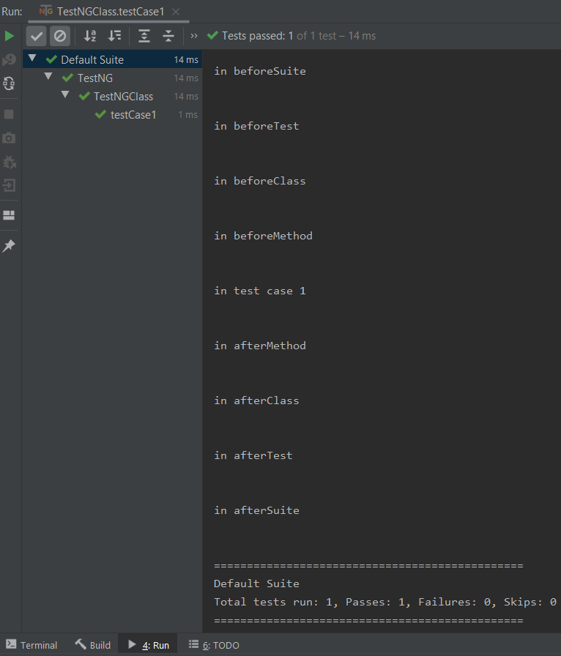
Use of TestNG
Create Methods using Annotations:
Now try and execute only testCase1:
We can see that all declared annotated methods are executed, despite running only the one test method.

Slide 18
Use of TestNG
Parameters used with Annotations:
We can input parameters to the methods for test.
Parameters are keywords that modify the annotation's function.
Parameters require you to assign a value to them. You do.this by placing a "=" next to them, and then followed by the value.
Parameters are enclosed in a pair of parentheses which are placed right after the annotation.

Slide 19
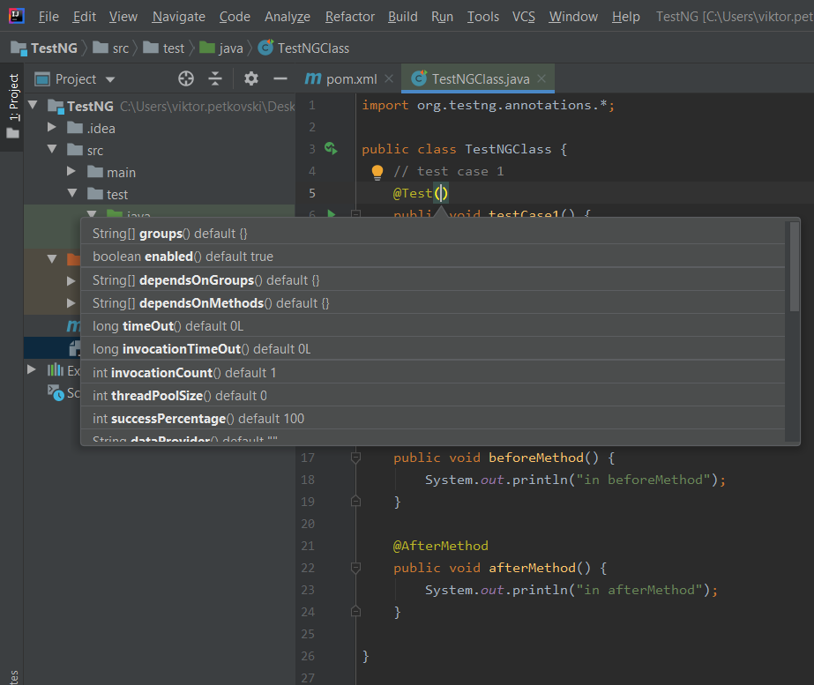
Use of TestNG
Parameters used with Annotations:
Just input parentheses next to the test annotation and possible solution suggestion will pop up.
We can set test method to have priority, to wait certain amount of time, to be dependent of other methods and many more parameters.

Slide 20
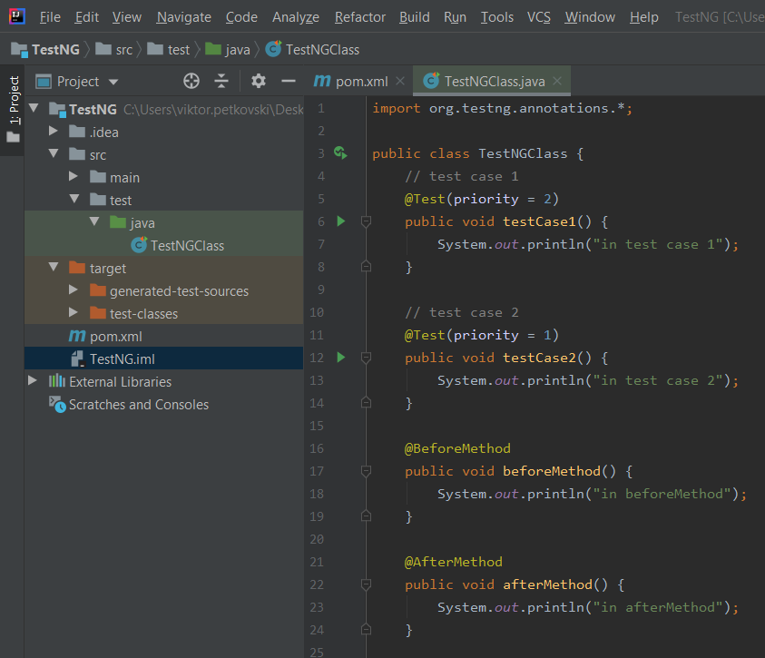
Use of TestNG
Parameters used with Annotations:
Let’s take a look at the following example:
We have two tests and each of them has certain priority value
Executing this class will execute the test with priority more important then other test.

Slide 21
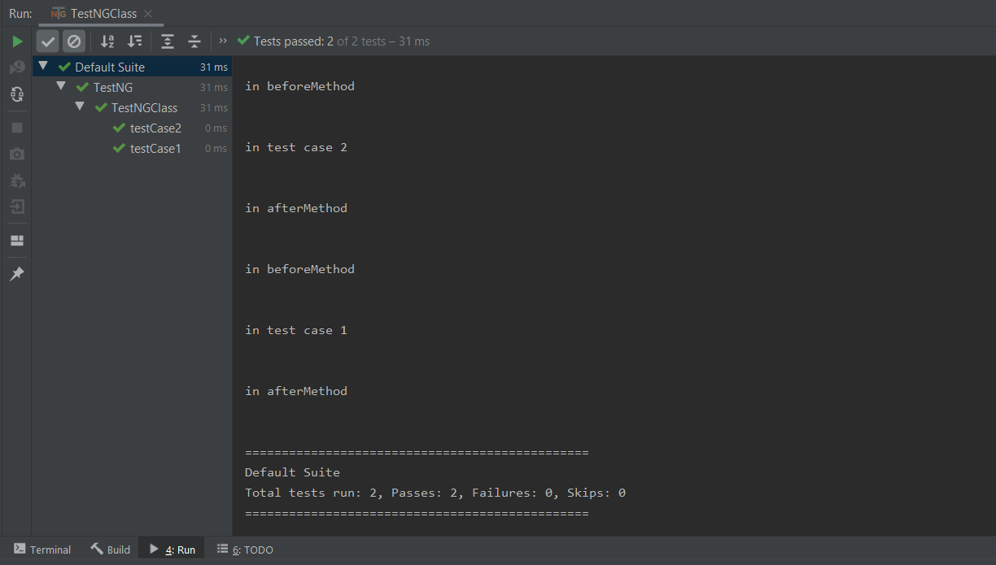
Use of TestNG
Parameters used with Annotations:
Below is the console output for the execution:

Slide 22
Use of TestNG
Parameters used with Annotations:
Some of the most common attributes for @Test annotations:
Attribute | Description
description | The description for this method.
timeOut | The maximum number of milliseconds this test should take.
priority | The priority for this test method. Lower priorities will be scheduled first.
dependsOnMethods | The list of methods this method depends on.
enabled | Whether methods on this class/method are enabled.
alwaysRun | If set to true, this test method will always be run even if it depends on a method that failed.

Slide 23
Use of TestNG
Create test Suite:
We can create test suite which will execute more than one test classes.
In order to be able to do that, we need to create XML file in which we will declare the name of the suite, give the name of the group of tests and give reference which class to be part of that suite.

Slide 24
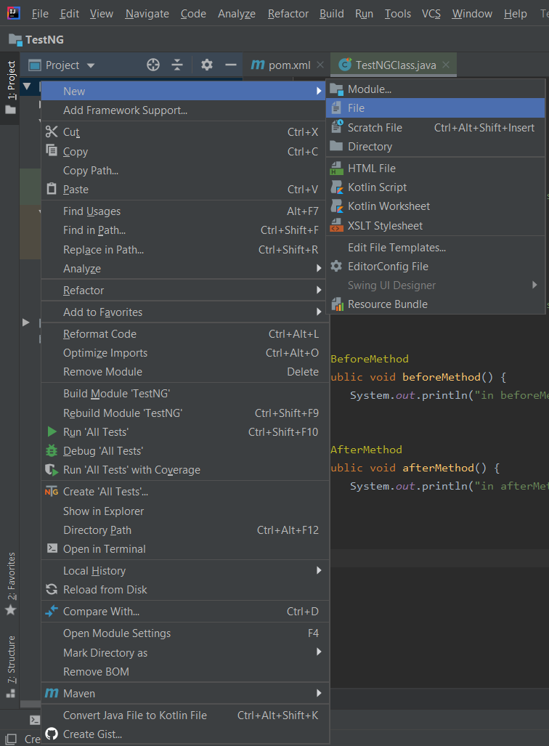
Use of TestNG
Create test Suite:
First, we will create XML file with name testing.xml
We will create this file in the project.
Go To: Right click on Project -> New -> File and input the file name.

Slide 25
Use of TestNG
Create test Suite:
Next, input the code below in the file:
<!DOCTYPE suite SYSTEM "http://testng.org/testng-1.0.dtd" >
<suite name="TestAll">
<test name="testNGClass">
<classes>
<class name="TestNGClass" />
</classes>
</test>
</suite>

Slide 26
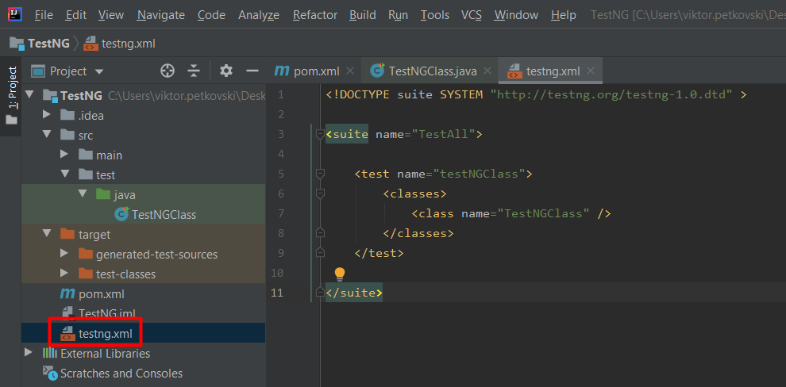
Use of TestNG
Create test Suite:
The file should look like this:

Slide 27
Use of TestNG
Create test Suite:
We can input as many classes as we want in this file, and of course, we need to do this manually.
We can group them in tests as it is shown.
To execute this suite, with Right Click on the xml file and just click Run

Slide 28
Assertions
Introduction:
Assertions are used for validating a test case and helps us understand if a test case has passed or failed.
The assertion is considered to be met if the actual result of an application matches with that of the expected result.
While automating web applications using Selenium, we need to validate our tests to verify if they are working as expected or not (that is, if a test case result is pass/fails).

Slide 29
Assertions
Types of Assertions in Selenium:
There are two types of assertions in Selenium and the categorization depends on how the assertion behaves after a condition is pass or fail:
Hard Assertions
Soft Assertions
Types of assertions
Hard Assertions
Soft Assertions

Slide 30
Assertions
Types of Assertions in Selenium:
Hard Assertion:
Hard Assertion is an Assertion that throws the AssertException when the test case is failed.
In the case of Hard Assertion, you can handle the error by using a catch block like a java exception.
Suppose we have two test cases in a suite. The first test case in a suite has an assertion that fails, and if we want to run the second case in a suit, then we need to handle the assertion error.

Slide 31
Assertions
Types of Assertions in Selenium:
Hard Assertion:
A Hard Assertion contains the following methods:
AssertEquals
AssertNotEquals
AssertTrue
AssertFalse
AssertNull
AssertNotNull

Slide 32
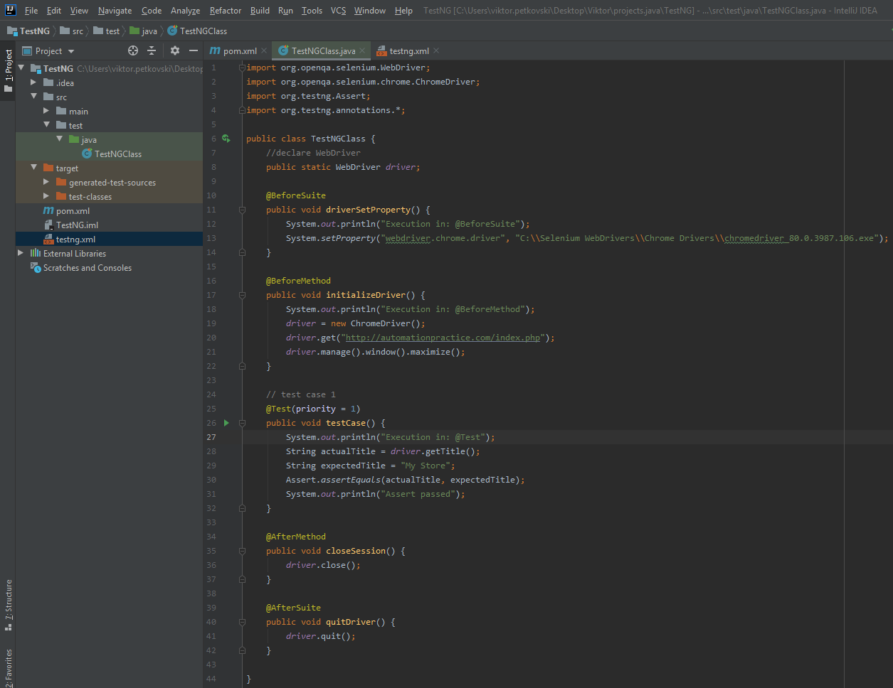
Assertions
Types of Assertions in Selenium:
Hard Assertion Example

Slide 33
Assertions
Types of Assertions in Selenium:
Soft Assertion:
Soft Assertions are the type of assertions that do not throw an exception automatically when an assertion fails unless it is asked for.
This is useful if you are doing multiple validations in a form, out of which only a few validations directly have an impact on deciding the test case status.
When softAssert is used, it performs assertion and if an exception is found, its not thrown immediately, rather it continues until we call the method assertAll() to throw all exceptions caught.

Slide 34
Assertions
Types of Assertions in Selenium:
Soft Assertion:
To use a soft assertion in testNg, we have to include it’s corresponding class (as SoftAssert()) in the script.
This class prevents the execution to throw any exception (of assertion).
Also, the most important context is, now the failed assertions will be reported in the testNg report and not making the test to abort anywhere.

Slide 35
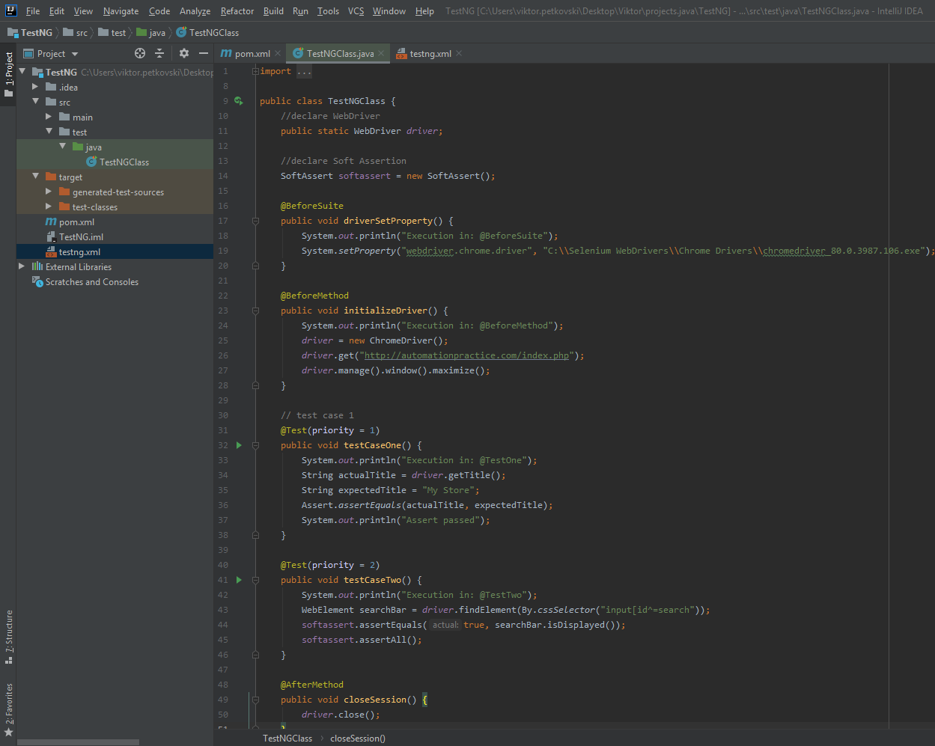
Assertions
Types of Assertions in Selenium:
Soft Assertion Example

Slide 36
Assertions
When to use Hard and when to use Soft Assertions in Selenium:
If you need to execute all the steps of a test case to be executed even after an assertion fails, and you also want to report assertion exception, then opt for using Soft Assertions.
Using Soft Assertions in your test scripts is a good practice and an effective way of handling your test execution.
If you want your test case execution to proceed only after an assertion is passed (for ex. verify valid login and only then execute the other steps), then use Hard Assertions.

Slide 37



